Slide 1

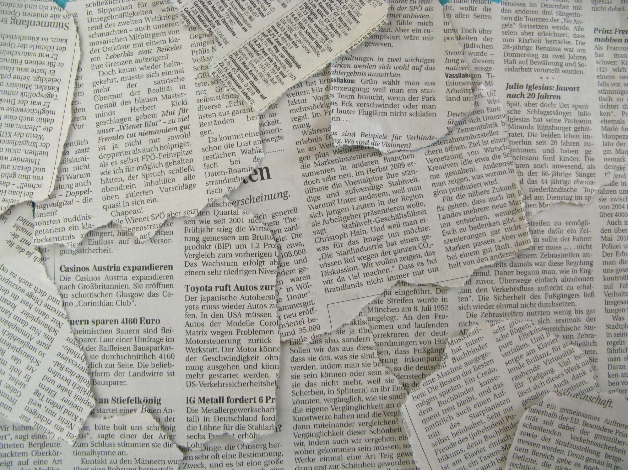
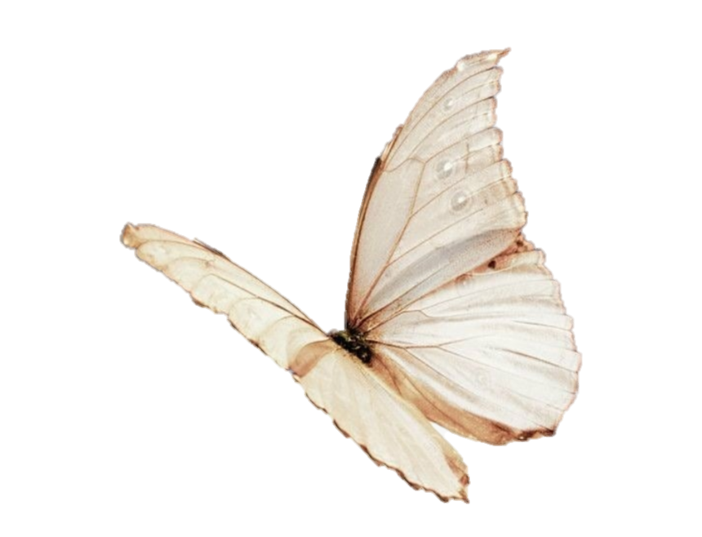
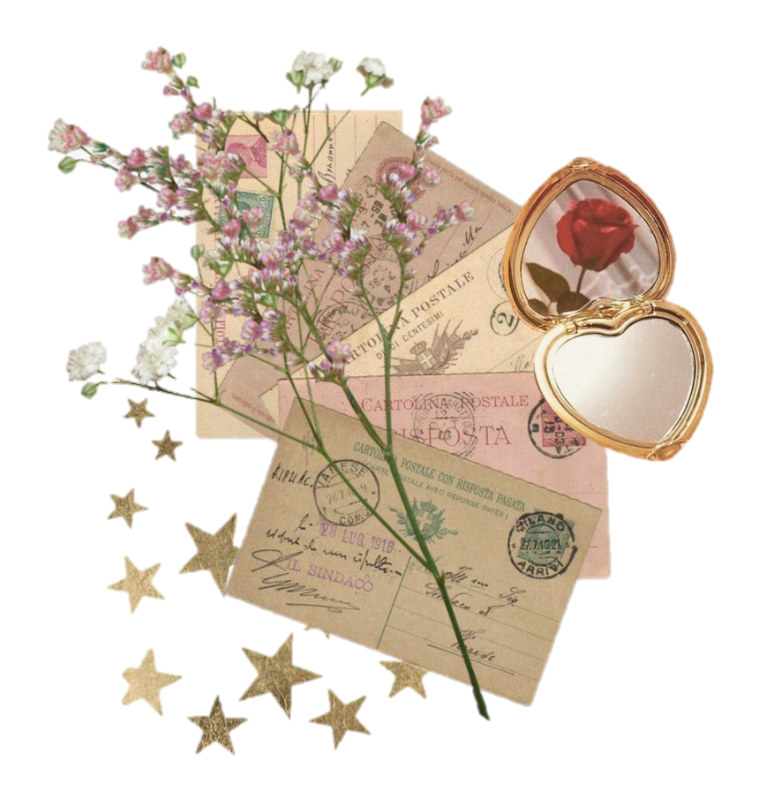


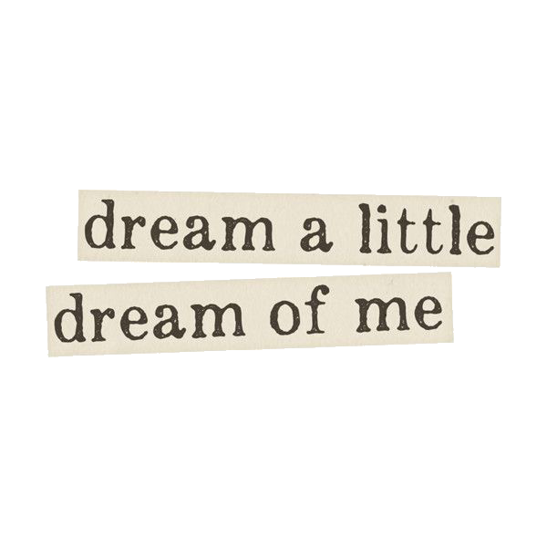
my favourite weather.
group 2

Slide 2


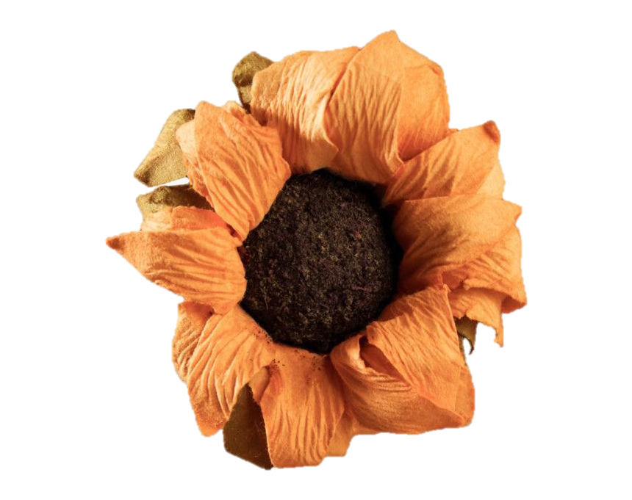
Spring
I just want to tell you about the spring , which is my favorite season. it starts as soon as february last all the way till late may .

Slide 3




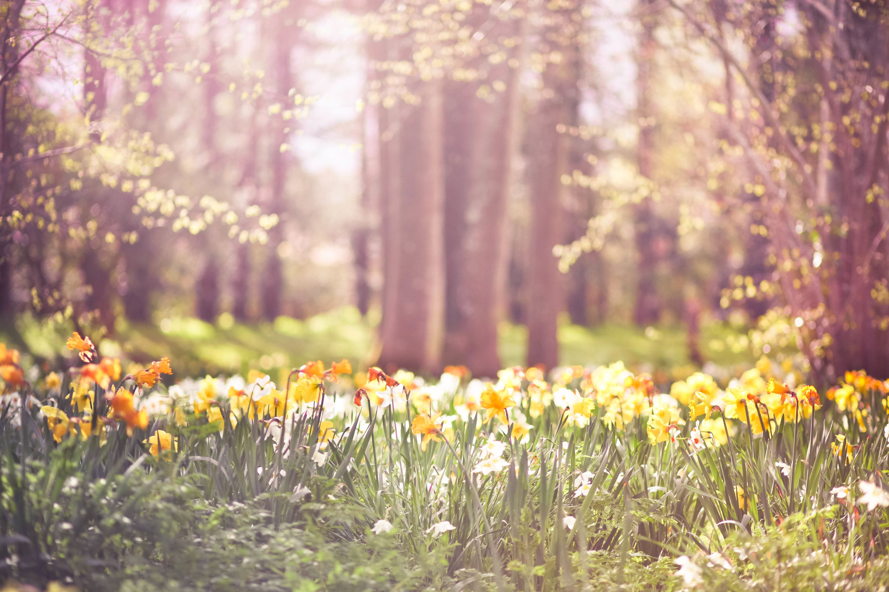

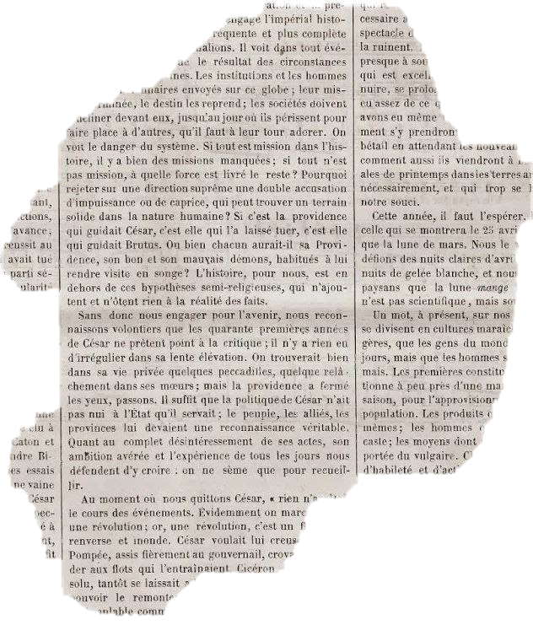

The Title

Slide 4
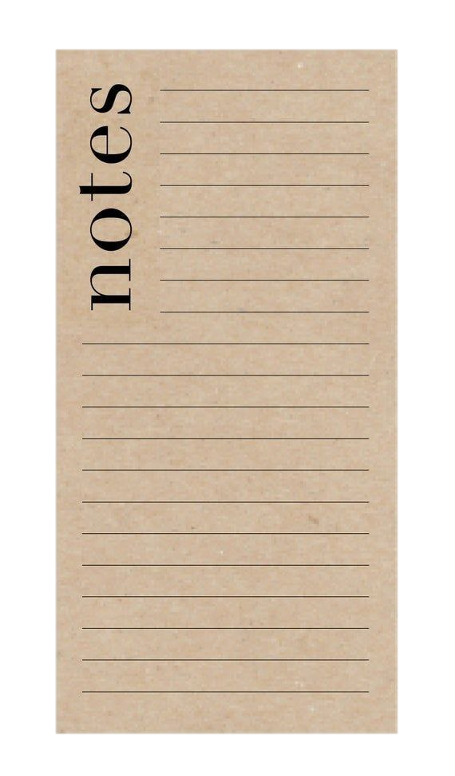

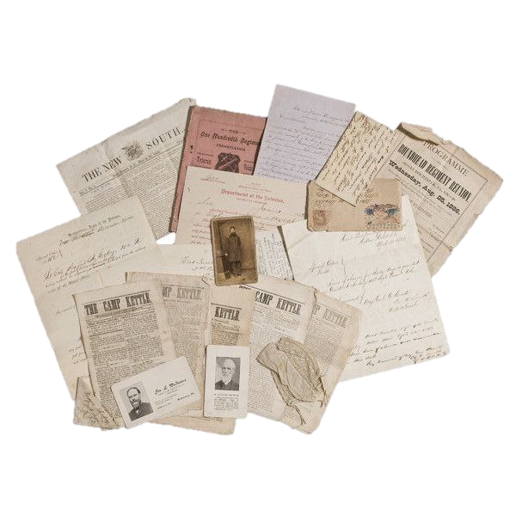
The Title
And everything was written here. Everything everything everything everything everything everything everything everything Everything everything everything everything everything everything everything everything Everything everything everything everything everything everything everything everything

Slide 5



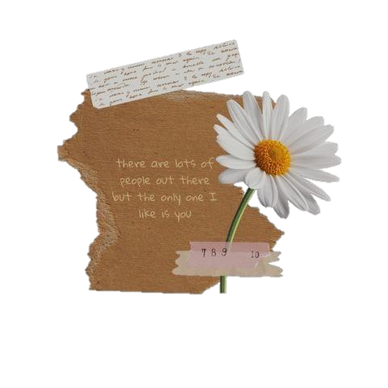
The Title
The Title
And everything was written here. Everything everything everything everything everything everything everything everything Everything everything everything everything everything everything everything everything Everything everything everything everything everything everything everything everything

Slide 6
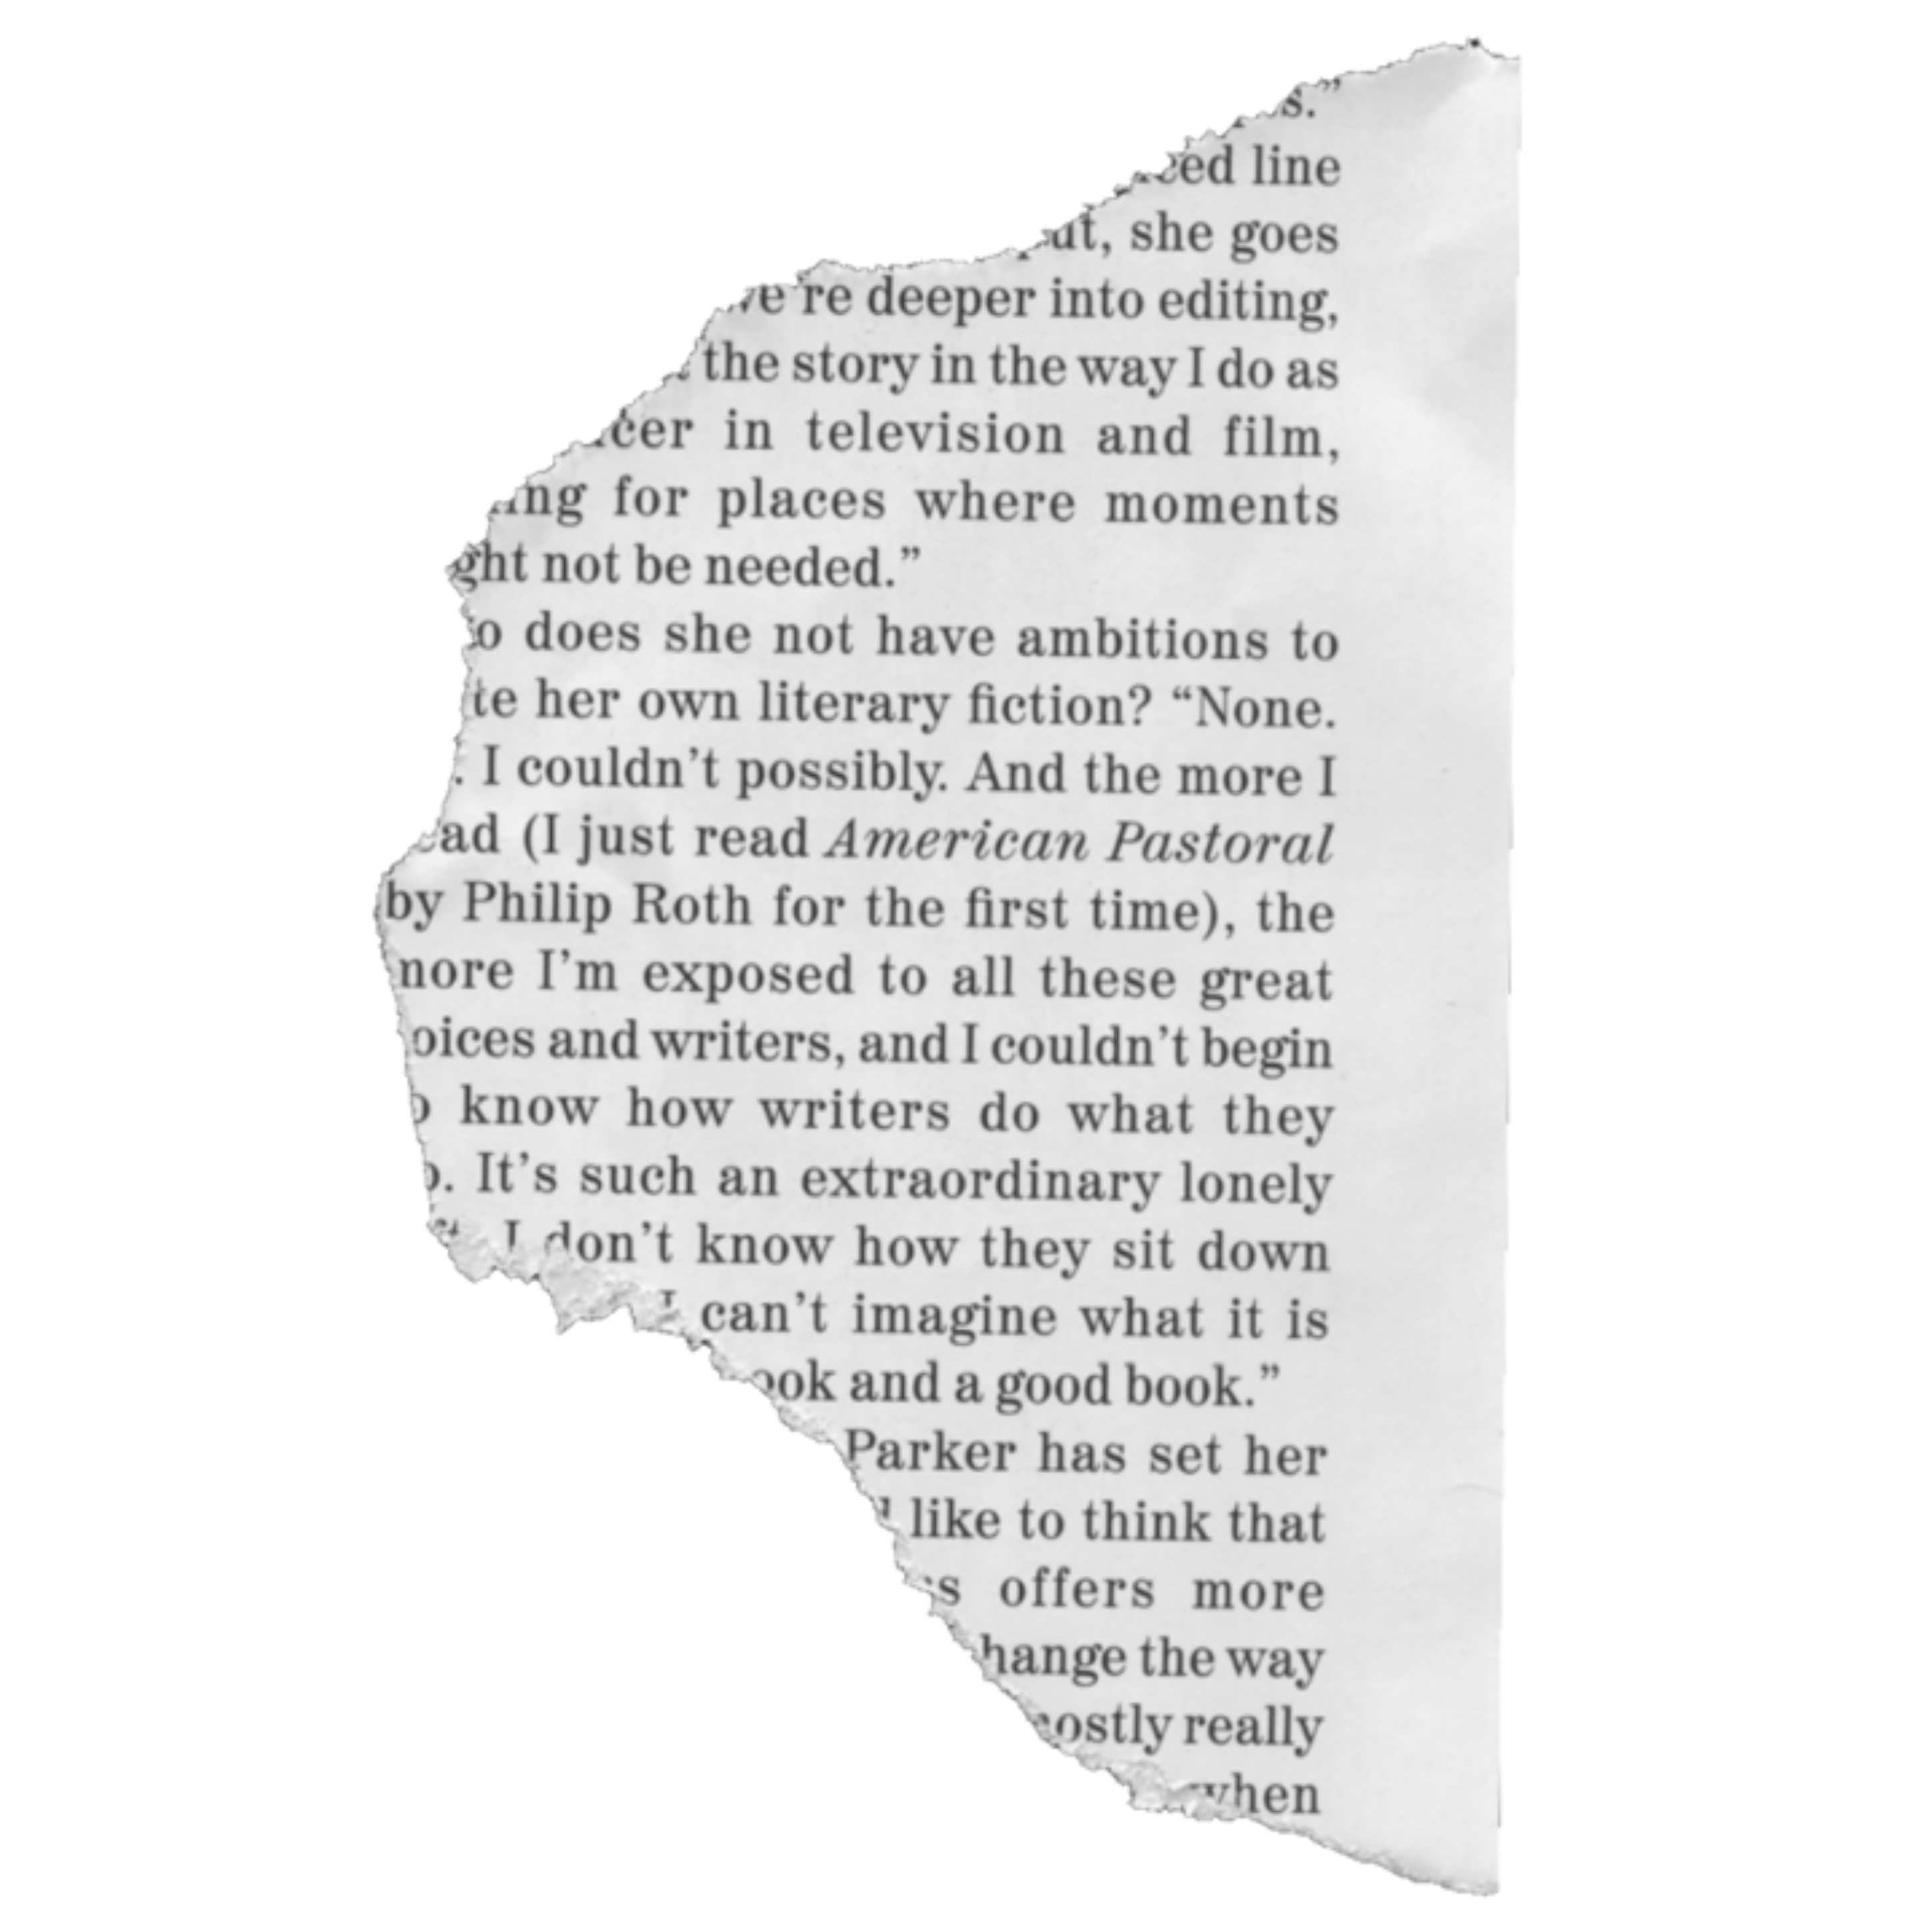


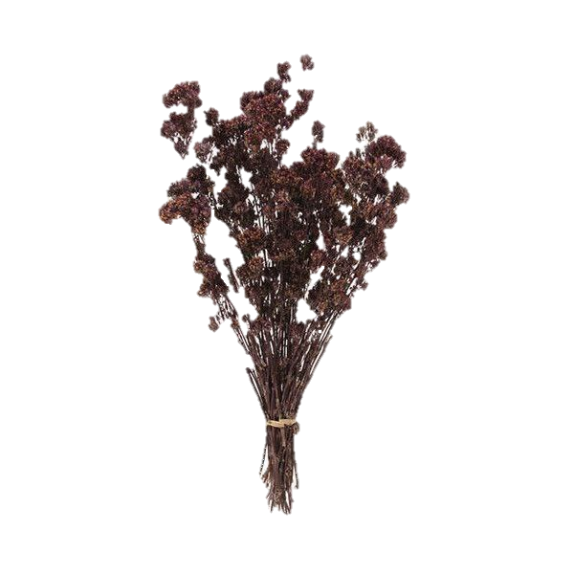
The Title
Don’t flirt
Soso
Millions
Her
Aurora
Don’t be shy
Dress up
Mola
Song 4 U
Lost in a crowd
Flamenco
Call anytime
Dduk
Wind
Instinctively
Body

Slide 7
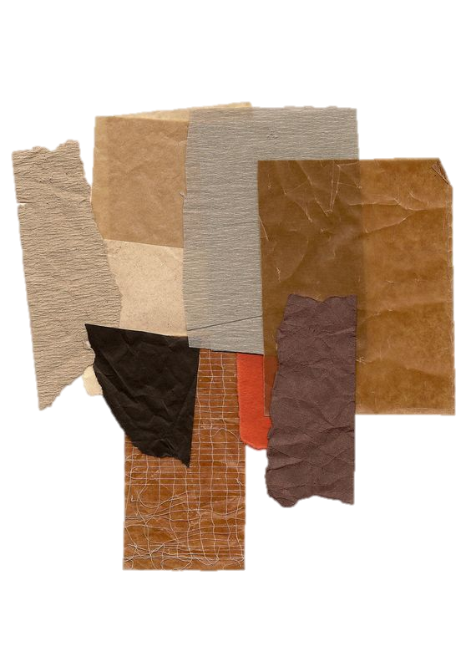
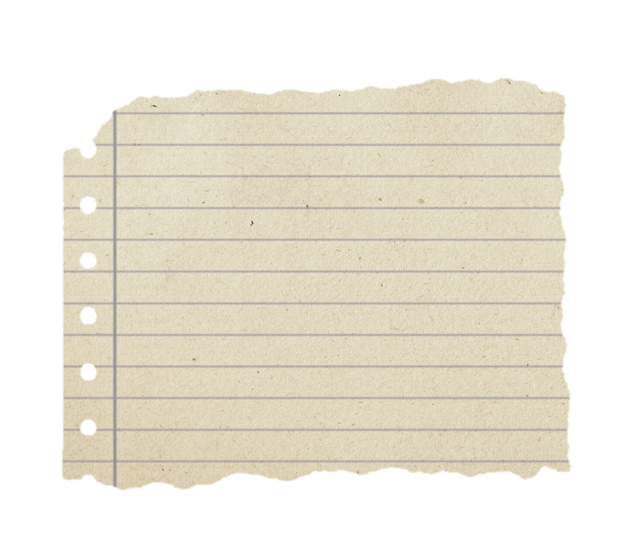

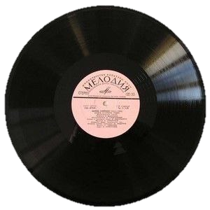
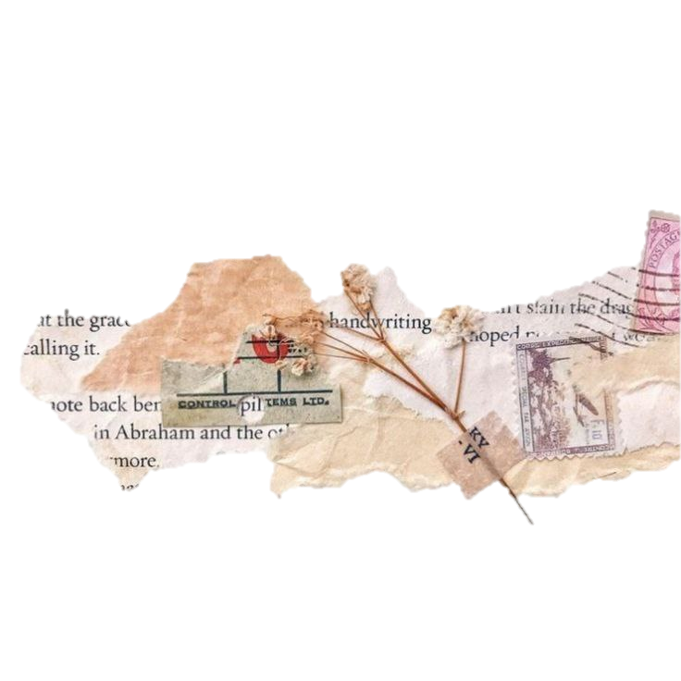

The Title
The Title
And everything was written here. Everything everything everything everything everything everything everything everything Everything everything everything everything everything everything everything
And any other everything
Stan winner for better
Life.

Slide 8
